Slide 1


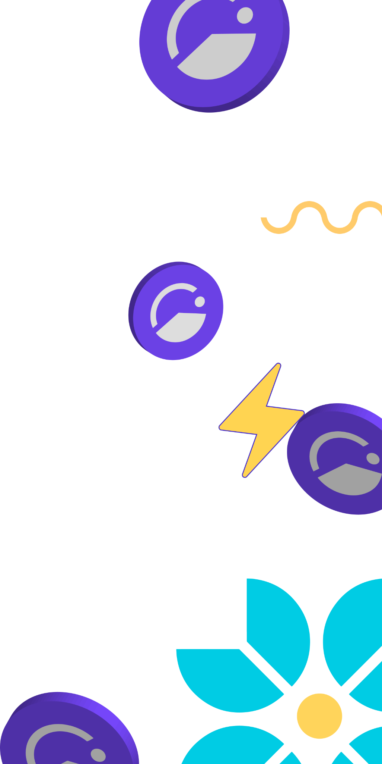

Giveth is rewarding and empowering those
who give to projects, to society, and to the world!
Giveth is rewarding and empowering those who give to projects, to society, and to the world!

Slide 2










Using web3 to evolve philanthropy
Giveth has the best donation platform in the world & MORE!
better for non-profits
better for
donors
better for stakeholders
better for
impact DAOs
100% donations go from donors to projects anywhere in the world.
Donors get an upside by getting rewarded with GIVbacks. (Incentive program that rewards donors with GIV.)
GIV holders can earn a yield participating in the GIVeconomy.
ReFi organizations can reward their community with Regen Farms.

Slide 3
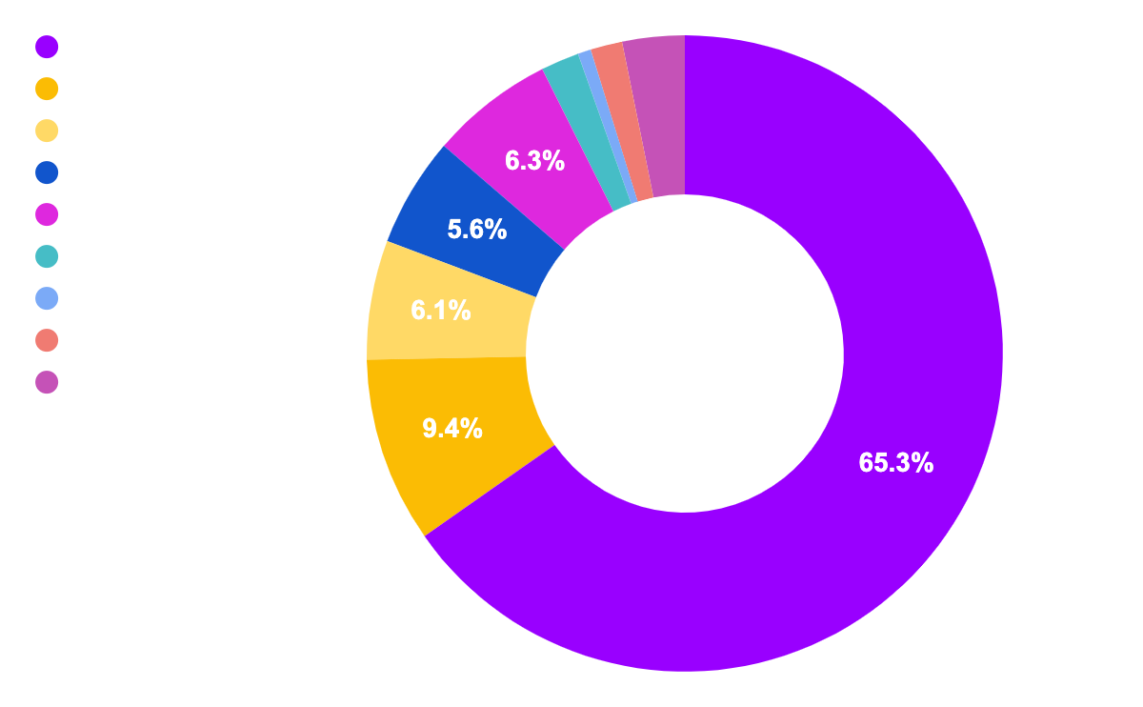
86% of our unique donors joined since March ‘21, and the numbers continue to grow!
Giveth in numbers
Total donated: $3,607,186 USD
# of projects: 2,209
# of donations: 14,327
# of unique donors: 6,138
$ 3,607,186
Total
Top 10 categories raised by total

Slide 4
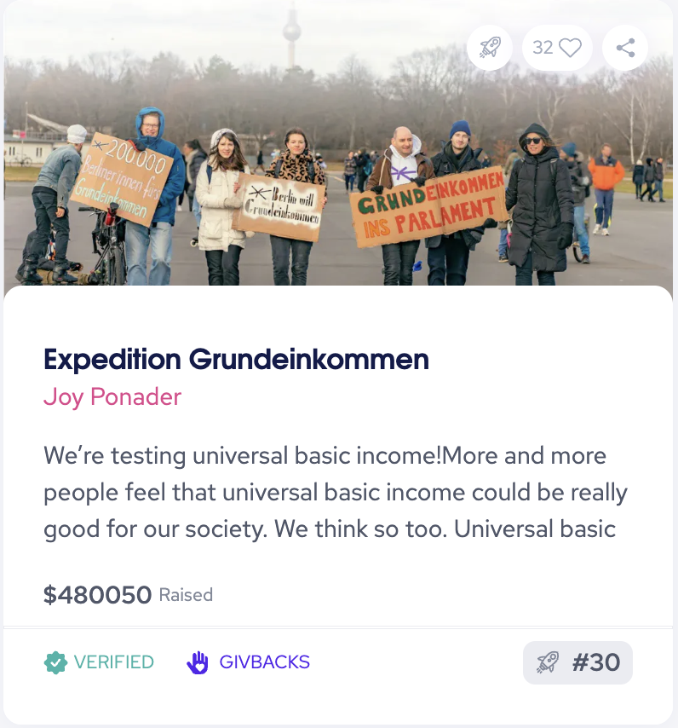
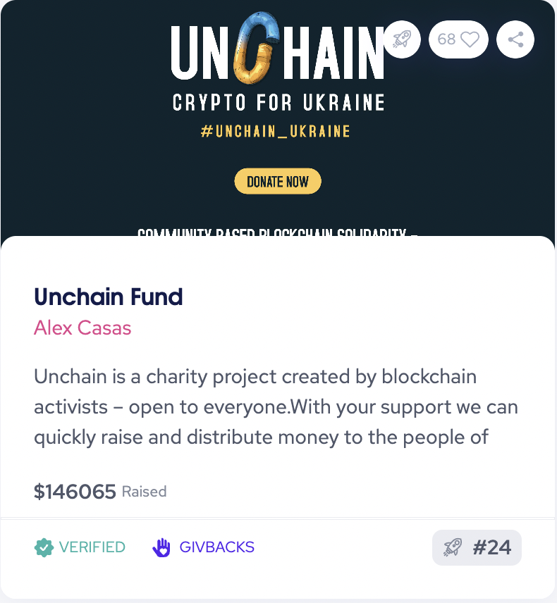
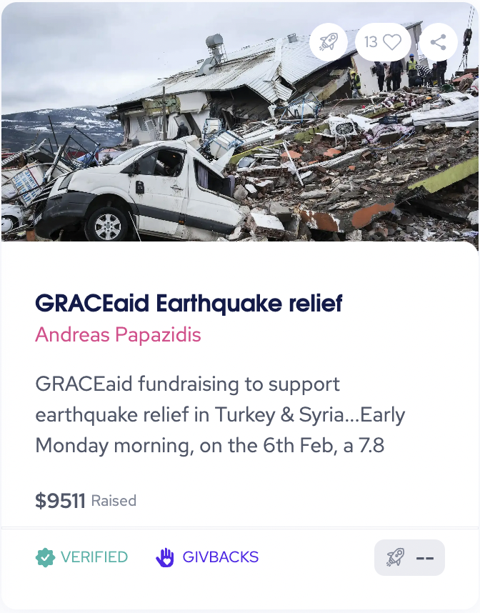
We are making global impact

Slide 5




Giveth ecosystem
Below is a quick run-through of the major pieces of our ecosystem that can be offered on your charity platform:
GIV
A transferable ERC-20 token that lies at the heart of the future of giving (native to Mainnet).
GIVbacks
The entry point to the GIVeconomy. Donors to verified public goods projects get GIV tokens in return. This flips the script on tax deductible donation, creating a decentralized and borderless way of incentivizing donations.
GIVpower
Donors can lock their GIV tokens for GIVpower and use them to boost/curate projects on the platform. Projects with more GIVpower are ranked higher and in turn, their donors are rewarded with more GIVbacks.
Griff Green @thegrifft
Notes:
Gurves are the big dream of Giveth. Gurves turn donors into investors and volunteers into shareholders, coordinating all of the stakeholders around the nonprofit’s regen microeconomy. Ok i am going to skip over an explanation of Bonding how BC’s work… so if you don’t know, its ok, just believe me that this makes sense. Let’s say that Mutual Aid Mondays has ironed out the kinks around coordinating as a DAO with their reputation system and has become Mutual Aid Denver DAO and has 200k worth of GIVtokens staked behind it via GIVpower. They can start a Gurve.

Slide 6
Giveth ecosystem
Projects to be launched in 2023:
GIVfi
Latent donations on the platform can be used to generate a low-risk yield while waiting to be disbursed.
This yield is to support the GIV token holders, and a portion is given to the projects themselves (“GIVdowments”), enabling nonprofits or anyone to have a defi endowment. (PHASED ROLL OUT - 2023)
GIVmatching
Top-ranked public goods and for-good projects on the platform will have the opportunity to have their donations matched via a collectively funded matching pool. We are collecting funds for the matching pool at donation.eth and plan to work with the (Gitcoin) Grants 2.0 system when it is released (Q2 2023).
Griff Green @thegrifft
Notes:
Gurves are the big dream of Giveth. Gurves turn donors into investors and volunteers into shareholders, coordinating all of the stakeholders around the nonprofit’s regen microeconomy. Ok i am going to skip over an explanation of Bonding how BC’s work… so if you don’t know, its ok, just believe me that this makes sense. Let’s say that Mutual Aid Mondays has ironed out the kinks around coordinating as a DAO with their reputation system and has become Mutual Aid Denver DAO and has 200k worth of GIVtokens staked behind it via GIVpower. They can start a Gurve.

Slide 7
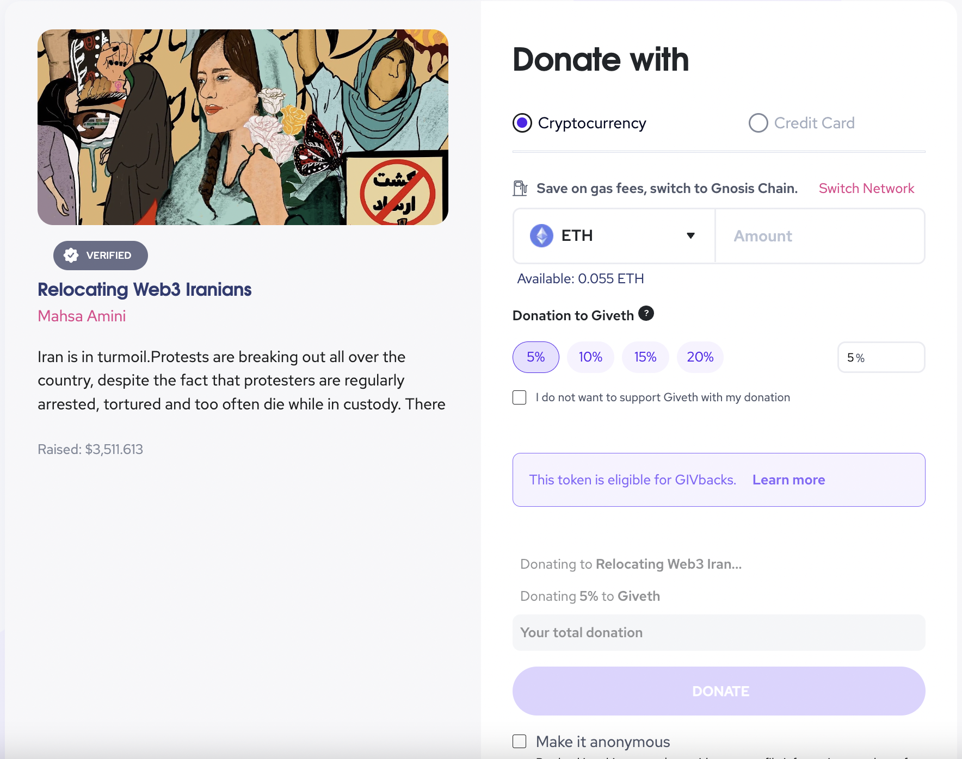
What we can offer
1
Upkeep and maintenance of the DApp
we can provide our devpower for updates, bug fixes, design requests, etc.
Managing and allocation of GIVbacks
we verify whether donations actually happened on Giveth (as opposed to happening outside of Giveth) and is eligible for GIVbacks
Adding all the GIVeconomy elements
GIVbacks, GIVpower, GIVfi, GIVmatching, etc.
Verification and onboarding of projects onto your donation application
we have our verification team who is manually checking and assuring the credibility of the projects applying on the platform
2
3
4
Griff Green @thegrifft
Notes:
Gurves are the big dream of Giveth. Gurves turn donors into investors and volunteers into shareholders, coordinating all of the stakeholders around the nonprofit’s regen microeconomy. Ok i am going to skip over an explanation of Bonding how BC’s work… so if you don’t know, its ok, just believe me that this makes sense. Let’s say that Mutual Aid Mondays has ironed out the kinks around coordinating as a DAO with their reputation system and has become Mutual Aid Denver DAO and has 200k worth of GIVtokens staked behind it via GIVpower. They can start a Gurve.

Slide 8


Development roadmap for launch
Front-end
Apply new design
Back-end
1 month
Amendments of new user flows
Product 1 month
. New template with personalized brand identity & visuals
. Revise user-flows to specific
user journey
Co-marketing
Partnership announcement post, Social Media,
Newsletter, Partner Spotlight, ie.:Twitter spaces
Test &
LAUNCH!
Post-launch activities
Partner use case blog post and/or TW thread
Co-education demo/Tutorial repos (your community or Youtube)
Griff Green @thegrifft

Slide 9
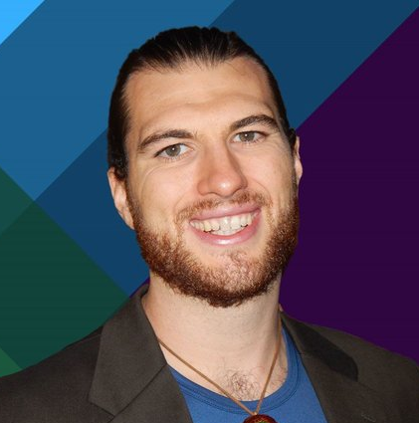
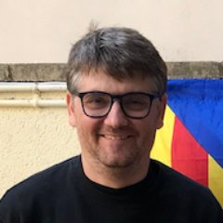

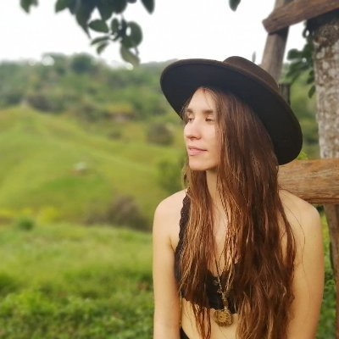
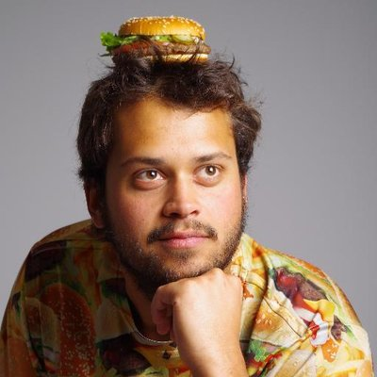

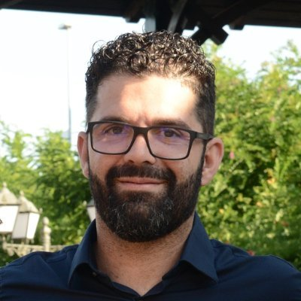
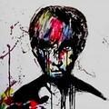
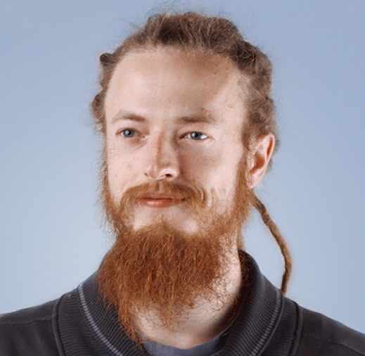
Our team!
Griff Green
co-Founder of the Commons
Stack, Giveth.io. Also co-founder of DAppNode and White Hat Group (WHG).
Jordi Baylina
co-founder of Giveth, DAppNode
and founder and technical lead of Polygon Hermez’ zkEVM and iden3.
Marko Prljic
Product and UX design lead at
Giveth, co-founder of General Magic.
Lauren Luz
Giveth communications lead and GIVeconomy product manager.
Mitch @divine_comedian
DAO steward, DeGov expert,
DevOps and development assistant.
Willy Ogorzaly
Head of Decentralization at Fox Foundation. Former CEO @bitfract acq: ShapeShift @JustLegal acq: DigitalTown.
Eduardo Antuña
DAppNode co-founder and
project lead. Ethereum DevOps and Solidity developer.
Sem @404ouch
Software engineer at 1Hive, Giveth.
Smart contract developer. Building GIVpower.
Oleksii Matiiasevych
Ethereum architect,
smart contracts engineer.
…and 50+ Giveth contributors

Slide 10

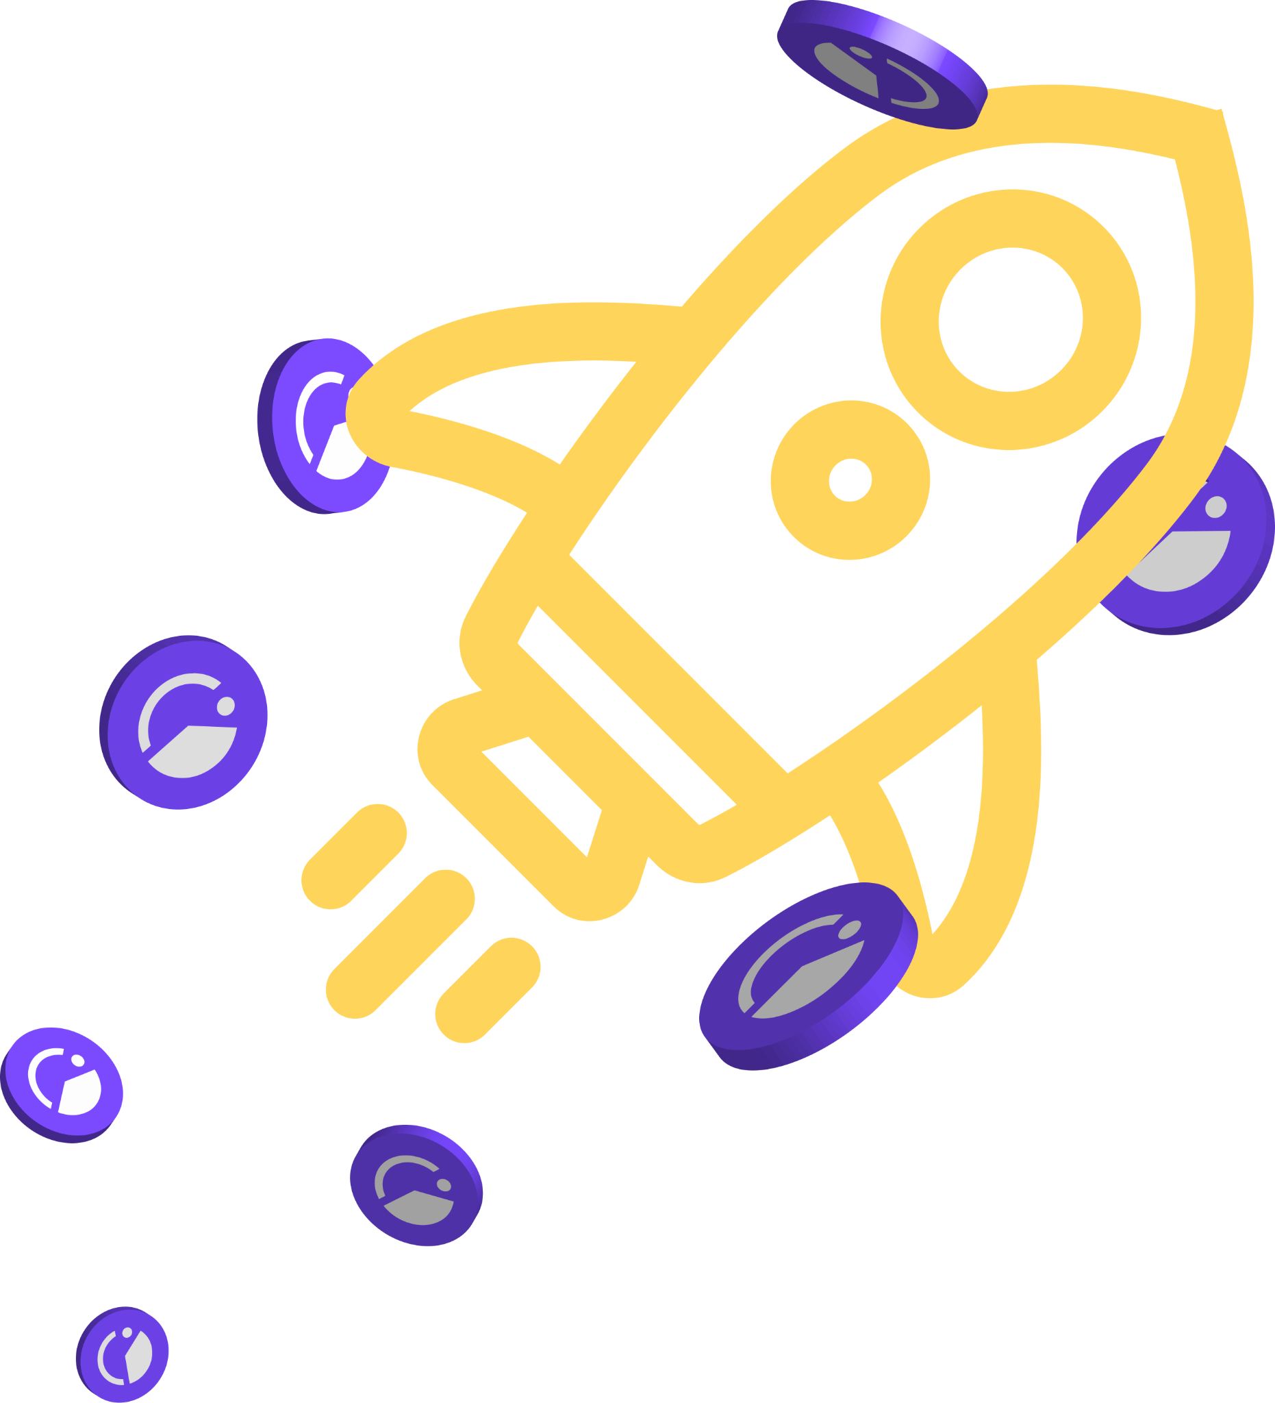
We look forward to
partnering up!
contact:
name@giveth.io
TG: @name

Slide 11

Join us in Building the
Future of Giving

